Slide 1
Pandit Deendayal Energy University Academic Year 2023-2024 Computational Engineering Laboratory
Presentation on Matlab Case Study
Presented by:
Vora Khyaat Darshan 21BME118D
Narinder Singh Bhadwal 21BME006
Presented To:
Dr. Annirudh Kulkarni
Assistant Professor
Department of Mechanical Engineering
Pandit Deendayal Energy University

Slide 2
Outline/Content
Case Study 1
Problem Statement
Derivations
Matlab Code
Results
Case Study 2
Problem Statement
Derivations
Matlab Code
Results

Slide 3
Case Study 1

Slide 4
Problem Statement
To Solve a problem on Heat Transfer of Natural Convection in H – Shaped Cavity.

Slide 5
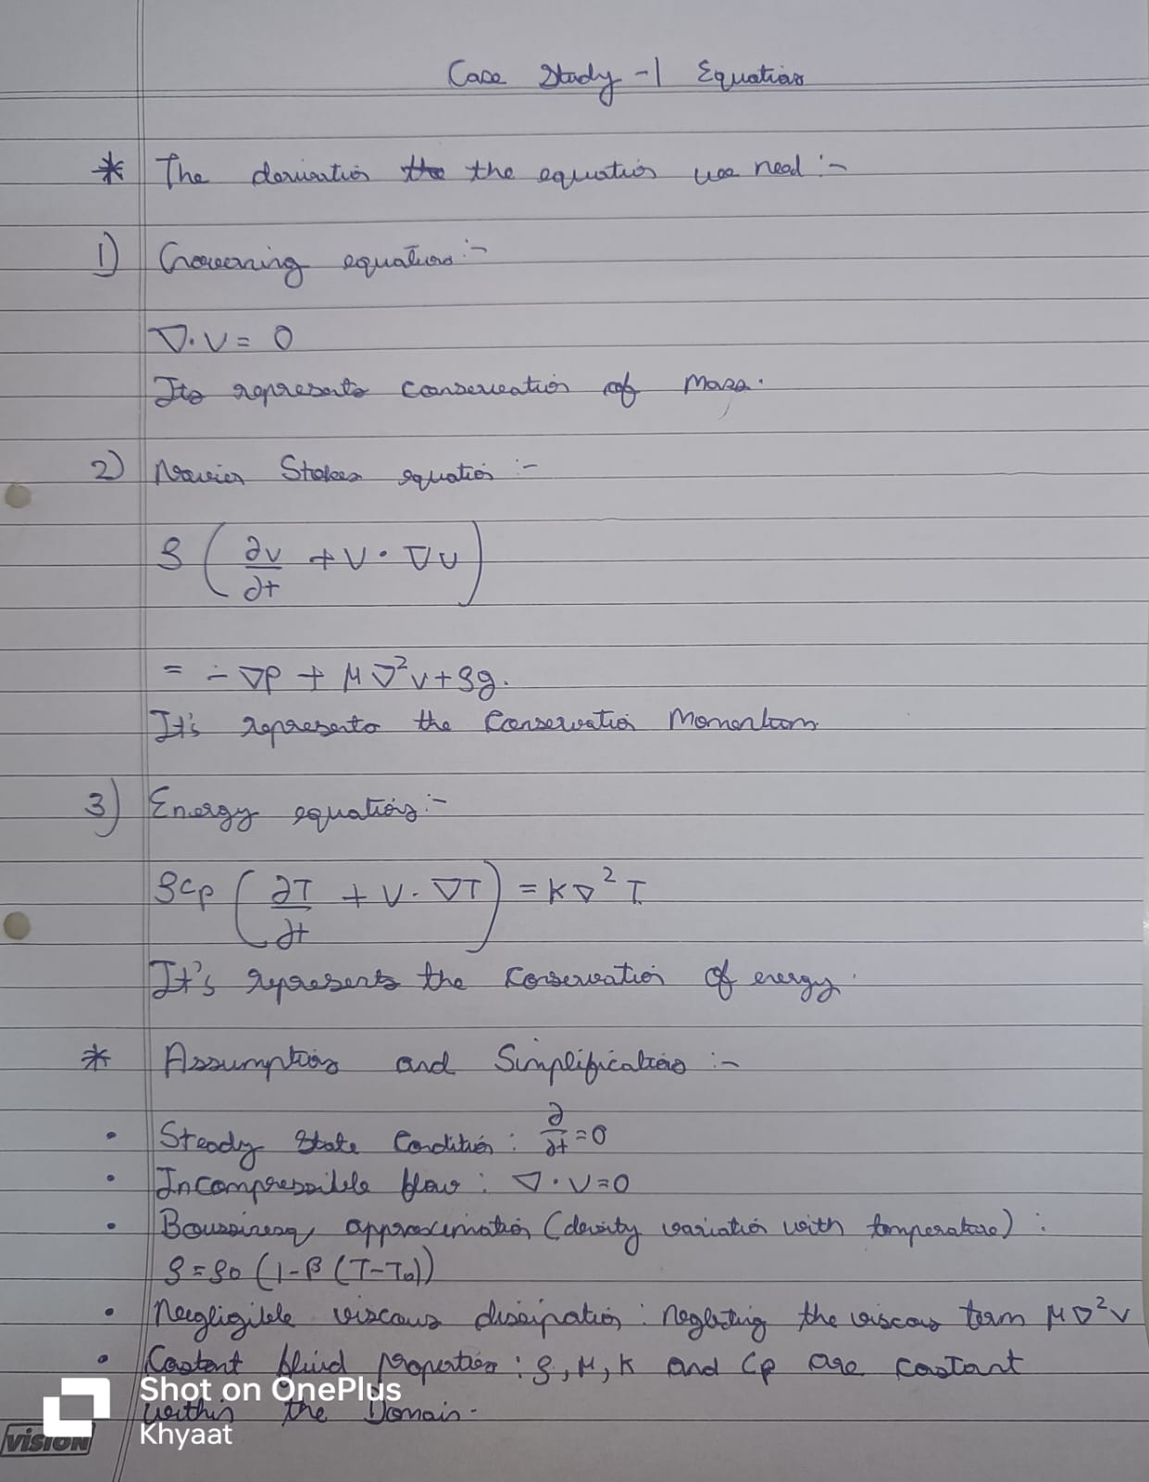
Derivations

Slide 6
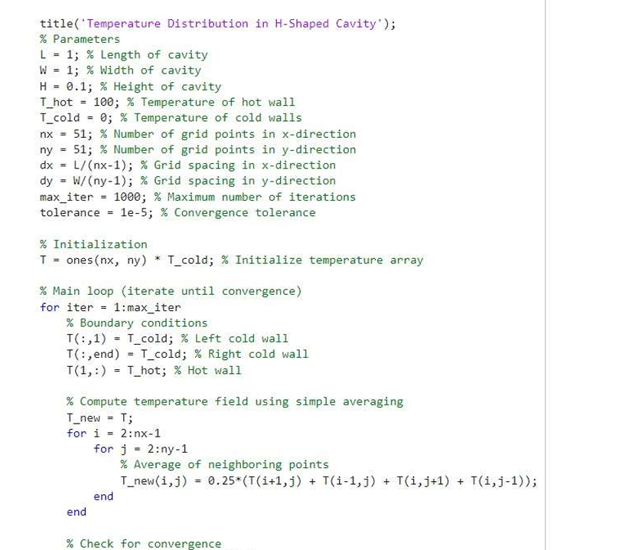

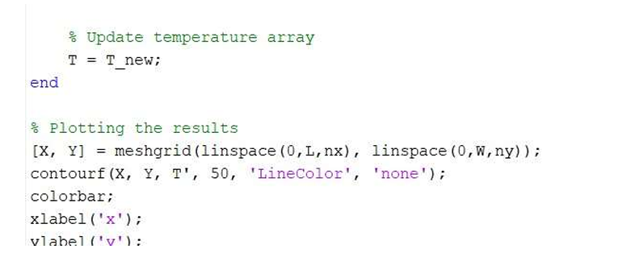
Matlab Code

Slide 7
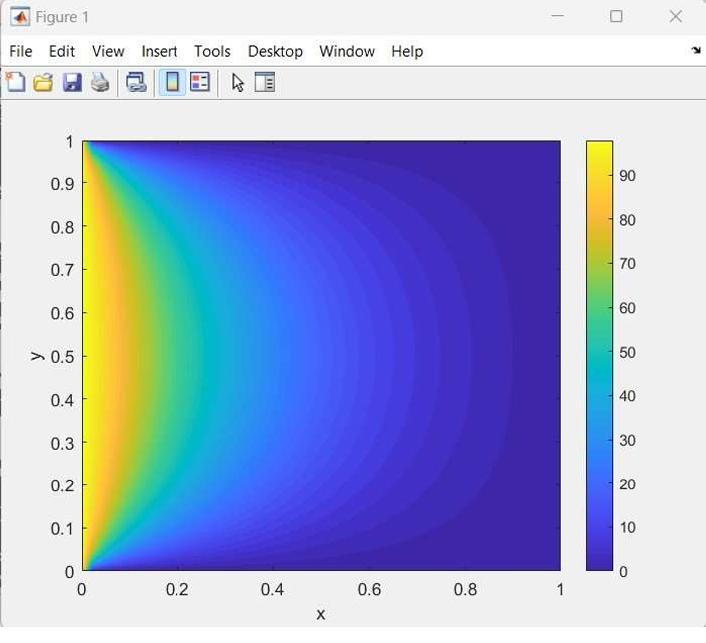
Results

Slide 8
Case Study 2

Slide 9
Problem Statement
To Update the code on the problem on Heat Transfer of Natural Convection in H – Shaped Cavity.

Slide 10
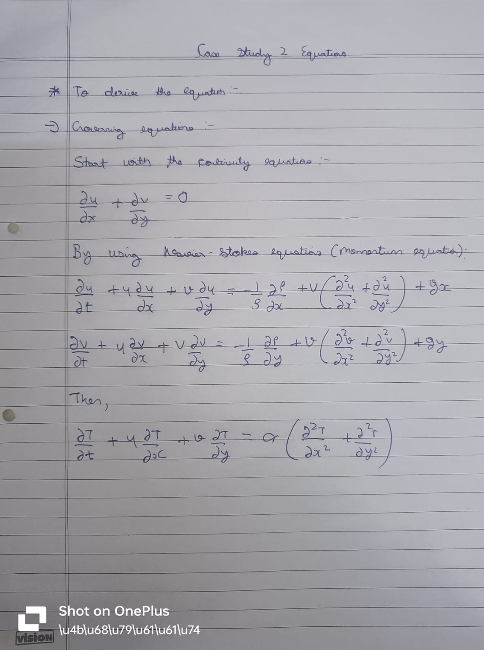
Derivations

Slide 11
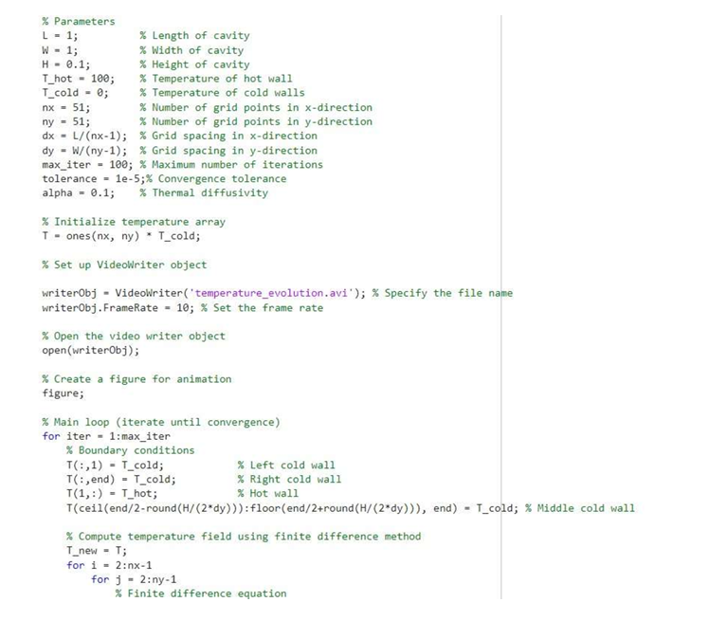
Matlab Code

Slide 12
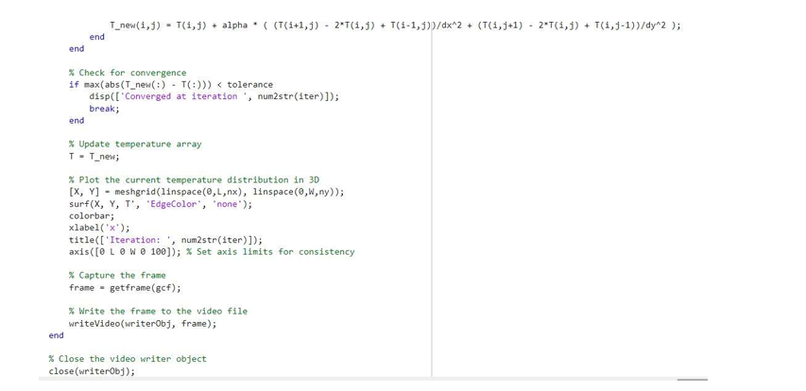
Matlab Code

Slide 13
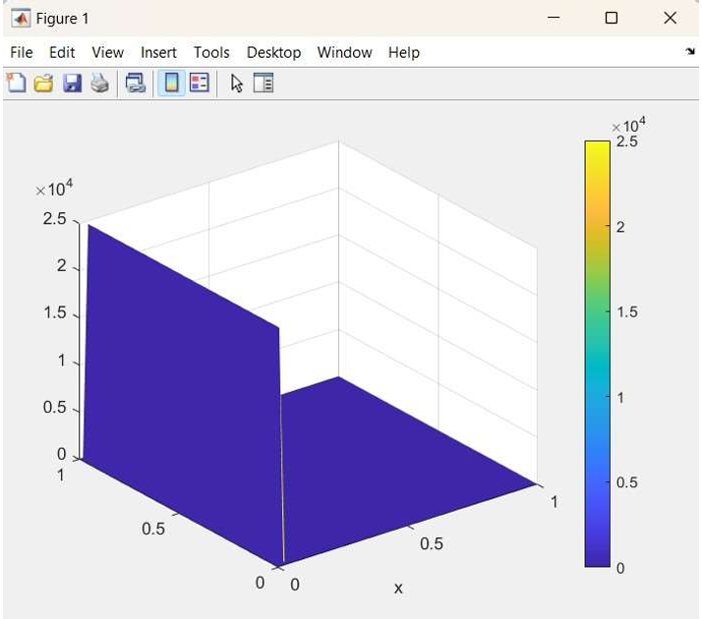
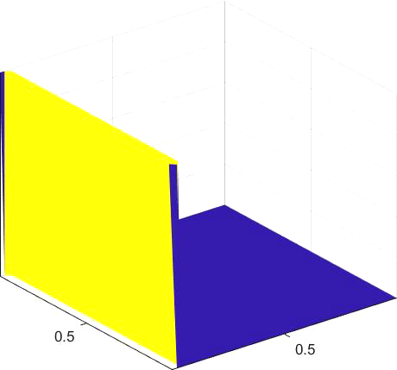
Results

Slide 14
Thank You

